Slide 1


OVERVIEW OF DTS RAPID HIV PROFICIENCY TESTING PROGRAMME
DR KEREANN NELSON
DIRECTOR, IMMUNOLOGY UNIT OF JAMAICA, MOHW

Slide 2


OVERVIEW OF DTS RAPID HIV PROFICIENCY TESTING PROGRAMME
The Dry Tube Test (DTS) Rapid HIV testing PT programme is 100% coordinated by the National Laboratory Services (NLS)
Laboratory Quality Assurance (QA) Coordinator plays an integral role in this activity

Slide 3

HISTORY
Panels were usually shipped three times each year to 42 sites.
Data collection, analysis, and generation of reports were done manually.
This was very labor intensive, about three weeks after the event to reporting.
There were some late submissions and misplaced result sheets.
The Quality Coordinator had to make many reminder phone calls.
Unable to meet reporting TAT.

Slide 4
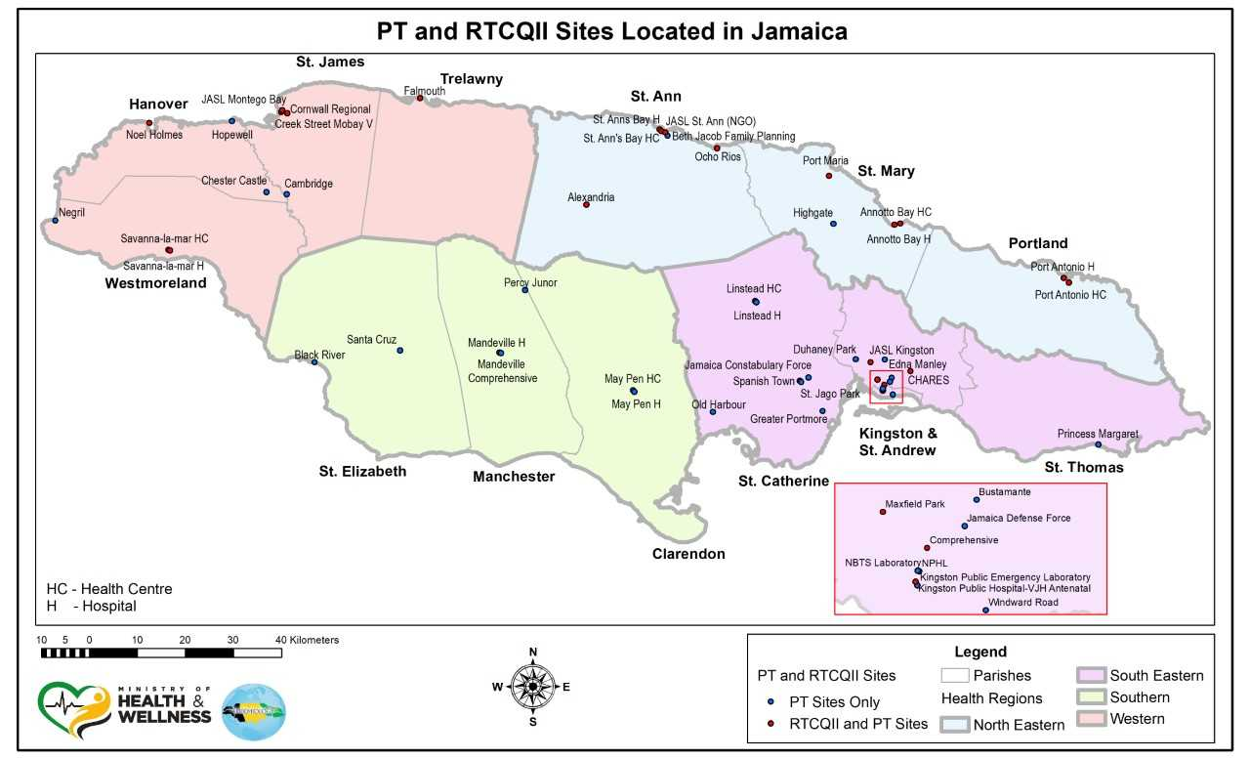
Participating Sites:
51 rapid HIV testing sites from across the island
  All 4 Regional Health Authorities
  Hospital laboratories
  Health Centres
  Non-Governmental Organizations (NGO’s)
  Government Labs
Notes:
NGOs
Beth Jacobs Clinic
Jamaica AIDS Support for Life (3 sites)
CHARES
UWI
Reference laboratory – HIV Department, NPHL which does confirmatory testing
NBTS Main Lab which also does HIV testing

Slide 5
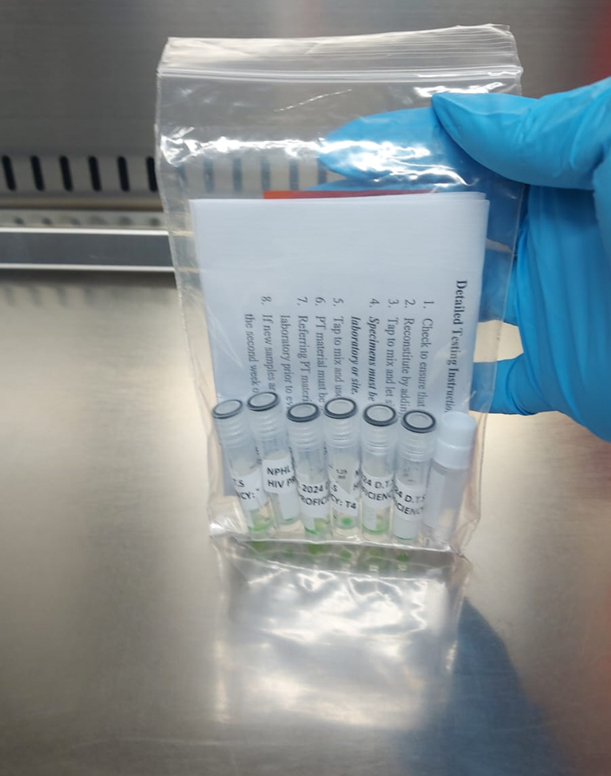
STAKEHOLDERS and ROLES
Quality Coordinator and team - prepare a six-sample test panel twice per year
Regional Medical Technologists/Supervisors - collect panels from NLS, distribute to site and return results in a timely manner
Testers – conduct testing in specified time and return results to NLS
Notes:
QA - Email alerts are sent to participating sites when panels are ready to be collected and reminders of the results submission deadline

Slide 6
Testing Site Supervisors
Arrange for collection of test panels
Supervise the testing and review the results prior to submission
Responsible for the implementation of any corrective action and reporting of same to the Laboratory QA Coordinator

Slide 7

PANEL PRODUCTION AND DISTRIBUTION
Panels are assembled and distributed
Team prepares the separate panels based on the sample order
Random samples are selected for quality checks
Notes:
QA Coordinator prepares the necessary documentation that will accompany the panel:
Instructions sheet
Results submission form
Site Labels for each package
PT code slips (states the PT Code for the test event, e.g. 2023S and the results submission deadline)

Slide 8

Panel Distribution
The QA Coordinator prepares a Panel Collection Log which is sent to the NLS Stores
The Panel Preparation Team sends the packages to the NLS Stores for distribution
Bearers collect their packages and sign the collection log

Slide 9
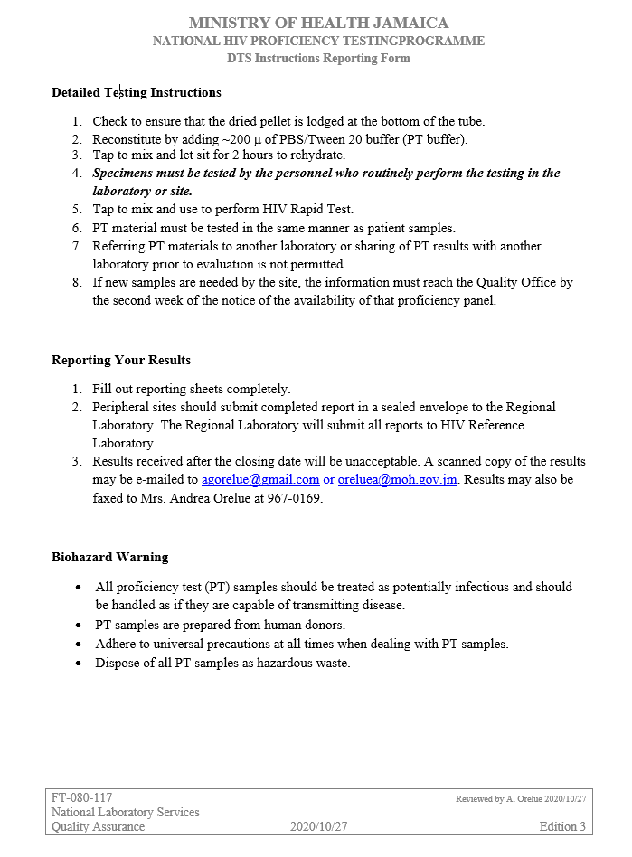

Slide 10
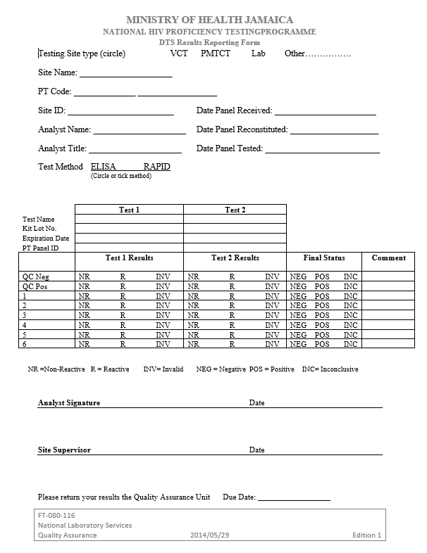
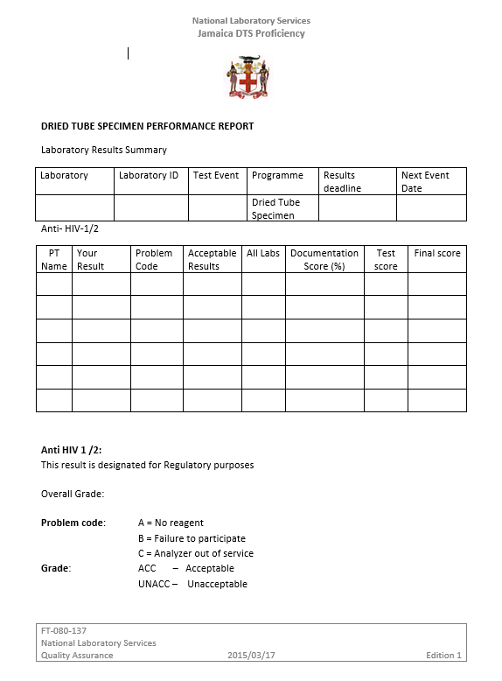

Slide 11
Testing Site Activities
Perform pre-testing activities (temperature checks, workstation disinfection, etc.)
Testing of positive and negative controls to ensure functionality of the test kits
Testing of the 6-sample PT panel
Recording of results on the Results Submission Form

Slide 12
Parameters analyzed by the ePT
Testing as set out in the national algorithm and all required documentation
Proper use of controls and reporting of control results
Results of the 6-sample panel
Documentation of final result

Slide 13
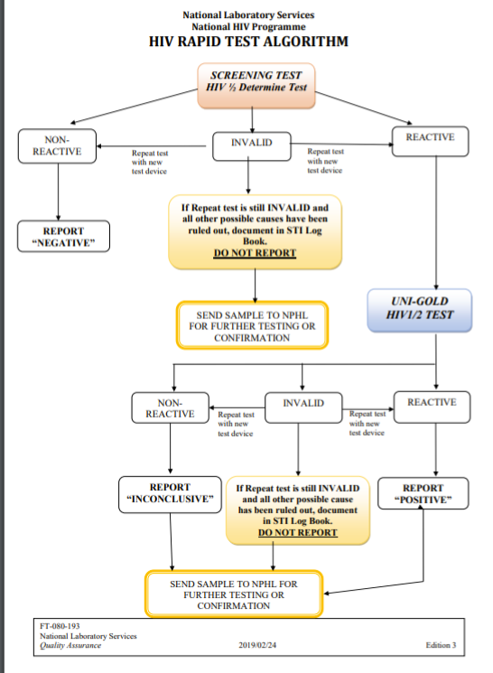

Slide 14

Performance Report
QA Coordinator prepares a performance report for each participating site. This includes the documentation, technical and average scores (%), and any recommended corrective actions to be implemented.
Prepares a Summary Report for each challenge which includes:
  Analysis by Region
  Comparison of current performance with previous performances
  Concerns regarding challenge failures and issues such as the need for additional training or site visits/audits

Slide 15
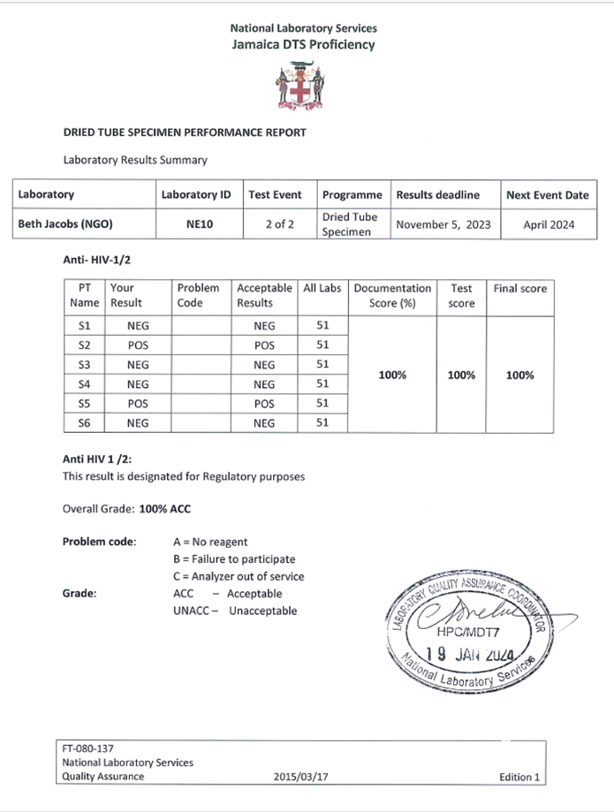
Example of a Performance Report

Slide 16
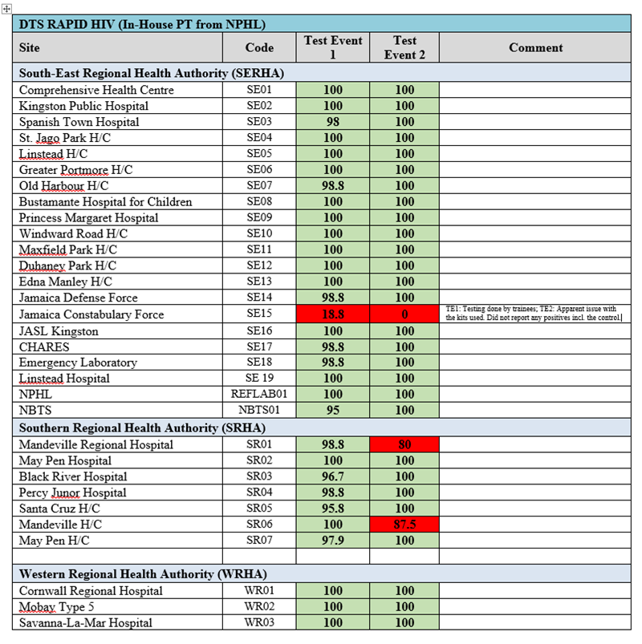
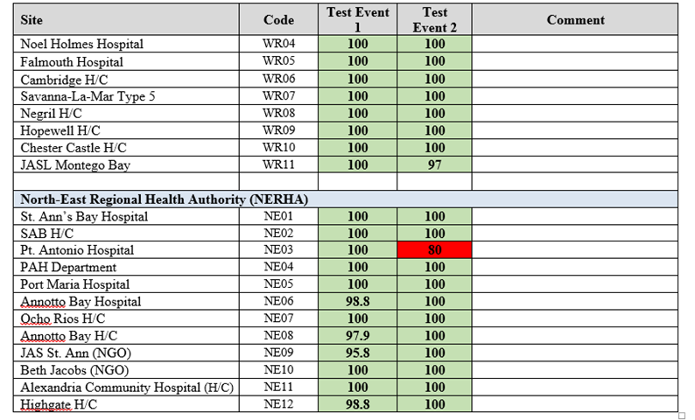
Notes:
Some Site Supervisors do a much better job than others.
Better documentation
Successive 100% performances
Training should be targeted towards the Site Supervisors (instead of focusing only on the testing personnel)

Slide 17


FUNDING & SUPPORT
Sponsorship from the CDC through GLESSN
Provision of items such as pipettes, cryovials, reagents (buffer), labels, etc. for the preparation of the test panels
Provide training for testing personnel
Provide logbooks for the testing sites
Provide an e-PT online platform to replace the manual method that has been in use for over 10 years in Jamaica
MOHW
Provide reagent kits through NHF
Provide PPE

Slide 18
LESSONS LEARNED
Sites that are followed up maintain level 4
Sites that implement Corrective actions excel in performance
Continuous training contributes positively to maintaining high standards

Slide 19
WAY FORWARD
CONSISTENT AUDITS
increase rapid HIV testing sites
ADD PT PROGRAM FOR Syphilis
Notes:
Updating the e-PT platform to include the submission and analysis of syphilis results

Slide 20
WAY FORWARD
VALIDATE NEW TEST KITS
Continual Improvement:
Develop a contingency plan in case there is a stock out of the kits currently in use
THIS WILL be included in the national testing algorithm

Slide 21


THANK YOU

